Slide 1
Cavalieri's Principle: Area and Volume
Jim King
University of Washington NWMI 2013

Slide 2
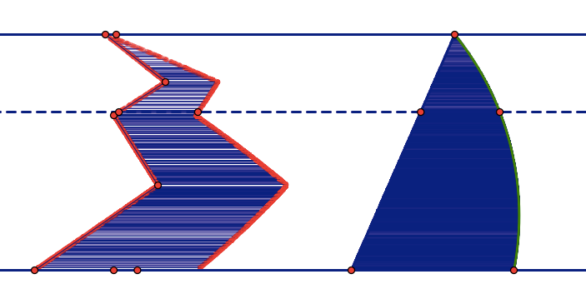
Cavalieri for Area
2-dimensional case: Suppose two regions in a plane are included between two parallel lines in that plane. If every line parallel to these two lines intersects both regions in line segments of equal length, then the two regions have equal areas.

Slide 3
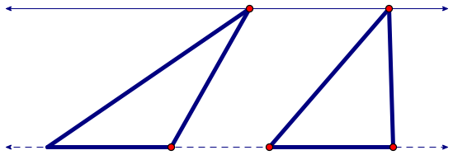
More Typical Examples
Two triangles with congruent bases and the same height have the same area.

Slide 4
Parallelograms
Parallelograms with congruent bases and the same height.

Slide 5
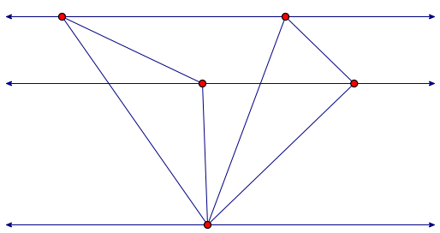
Even if there is no common base

Slide 6
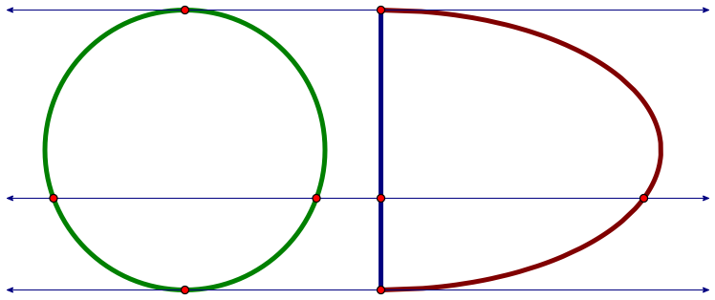
Other Plane Shapes

Slide 7
Cavalieri for Volume
3-dimensional case: Suppose two regions in three-space (solids) are included between two parallel planes. If every plane parallel to these two planes intersects both regions in cross-sections of equal area, then the two regions have equal volumes.

Slide 8
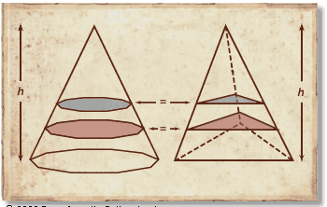
Two Pyramids with equal base area and equal height
Why are all the areas of slices equal if the bases are equal?

Slide 9
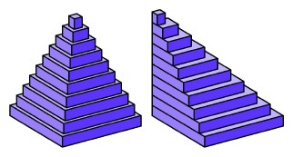
Key to why the volumes are equal
The volumes are approximately the sum of the volumes of the slabs of equal volume. The exact volume is a limit.

Slide 10
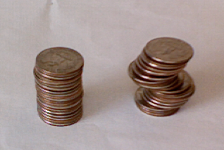
Decks of cards and stacks of CDs or pennies provide examples of equal volume

Slide 11
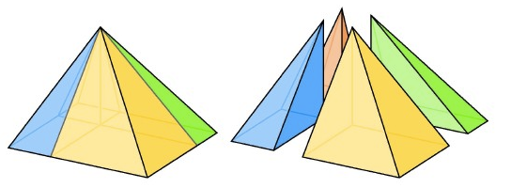
We have seen that for at least one pyramid inside a cube the volume = (1/3) base area x height
How can one show the formula for all pyramids?

Slide 12
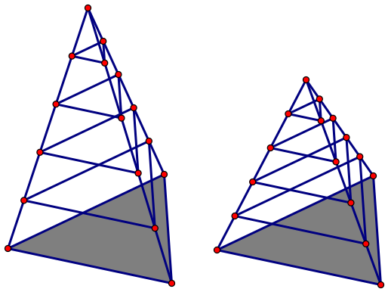
Scaling the Heights
If two pyramids have the same base but different heights, then the volumes are in the same proportion as the heights. Imagine two stacks of cards with the same number of cards but one is thicker than the other.

Slide 13
Changing the Base
If two pyramids have bases of different shape but the same area, one can break up the bases (approximately) into congruent small squares whose area sum is approximately the area of the base, so if one knows the formula for square bases, the formula is true for all bases.
Thus Volume = (1/3) area of base x height holds for all “pyramids”.

Slide 14
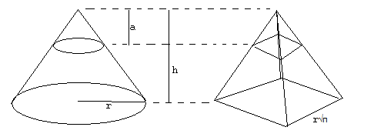
What’s a pyramid?
Cones count as pyramids in the previous discussion. The formula is the same for the same reasons.

Slide 15
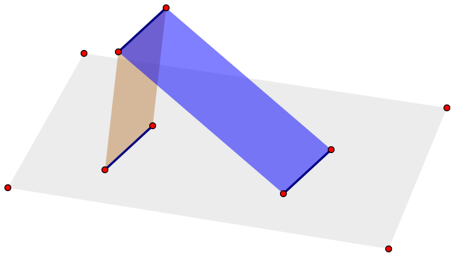
When Cavalieri is NOT true
Do NOT try to apply Cavalieri to areas of planes or surfaces in 3-space. This is just not true. Think of the example of a two slanting rectangles of the same height but different slope.

Slide 16
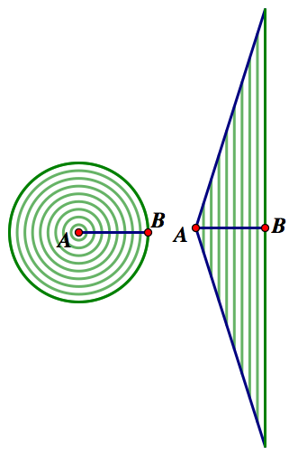
Circle Area = (1/2) radius x circumference
Instead of an arrangement of straight sticks, one can view a circle as a collection of concentric rings. When straightened, the area formula for a triangle becomes the area formula for a circle.

Slide 17
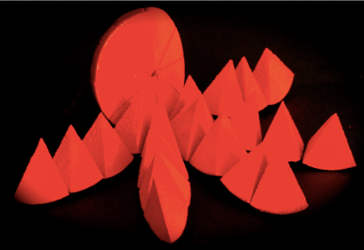
Sphere Volume = (1/3) radius x spherical area
The sphere can be cut (approximately) into pyramids. The “base area” = 4πr².

Slide 18
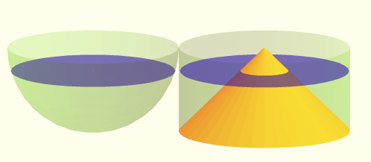
Even cooler proof of sphere volume
Use the Pythagorean Theorem to see that these slices have the same area.

Slide 19
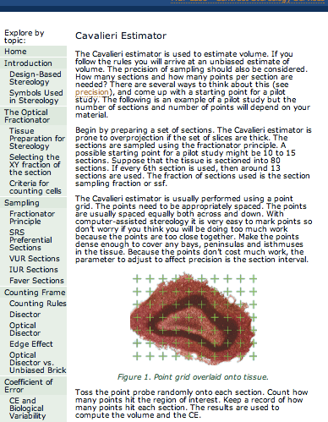
Application: modeling in stereology

Slide 20
Thanks, Sr. Cavalieri … & Zu Geng
Bonaventura Cavalieri(1598-1647) was an italian mathematician. He was a precursor of infinitesimal calculus. Cavalieri, Kepler and other mathematicians, who lived during the century preceding Newton and Leibniz, invented and used intuitive infinitesimal methods to solve area and volume problems.
Twenty years after the publication of Kepler's Stereometria Doliorum, Cavalieri wrote a very popular book: Geometria indivisibilibus (1635). In this book, the Italian mathematician used what is now known as Cavalieri's Principle.
Zu Geng, born about 450, was a chinese mathematician who used what is now know as the Principle of Liu Hui and Zu Geng to calculate the volume of a sphere. Liu-Zu theory is equivalent to Cavalieri's Principle.

