Slide 1
Network size and weights size for memorization with two-layers neural networks
Joint with Sébastien Bubeck, Ronen Eldan and Yin Tat Lee

Slide 2
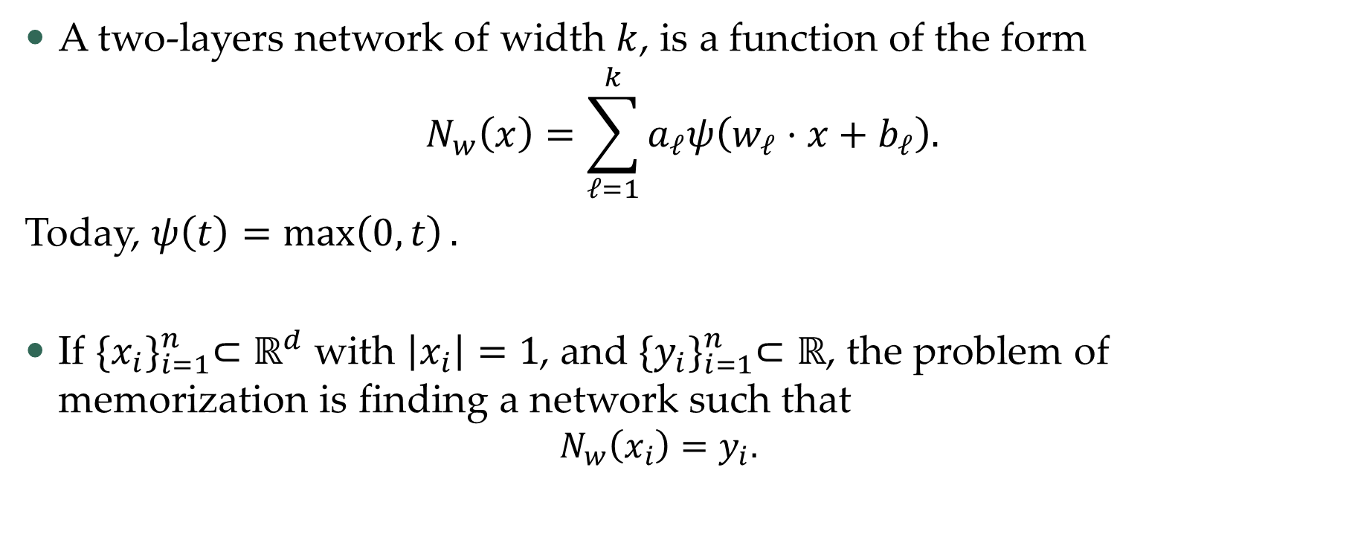
Some notations
A two-layers network of width $k$, is a function of the form
$$N_{w}\left(x\right)=\sum_{ℓ=1}^{k}{a_{ℓ}ψ\left(w_{ℓ}⋅x+b_{ℓ}\right).}$$
Today, $ψ\left(t\right)=\max\left(0,t\right).$
If ${\{x_{i}\}}_{i=1}^{n}⊂ℝ^{d}$ with $\left|x_{i}\right|=1$, and ${\{y_{i}\}}_{i=1}^{n}⊂ℝ$, the problem of memorization is finding a network such that
  $$N_{w}\left(x_{i}\right)=y_{i}.$$

Slide 3
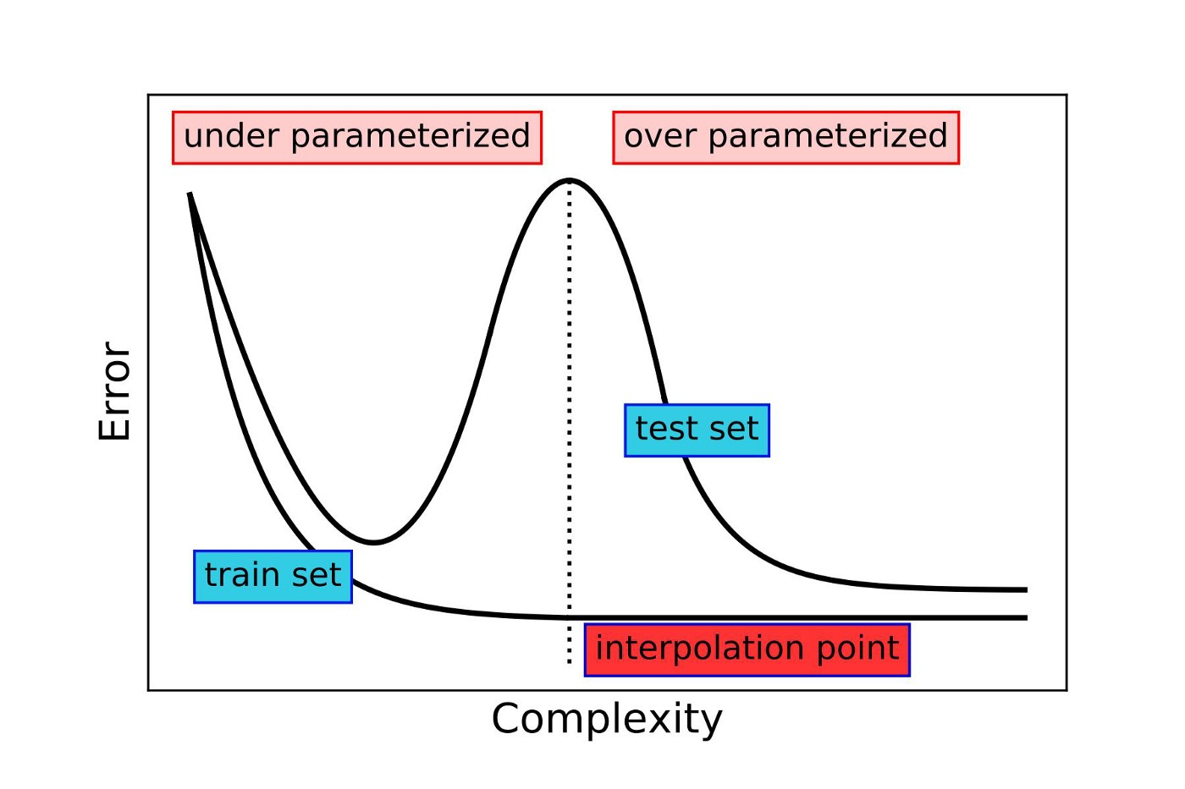
Why are neural networks popular?
Opinion: the double descent phenomena
Width
Memorization

Slide 4
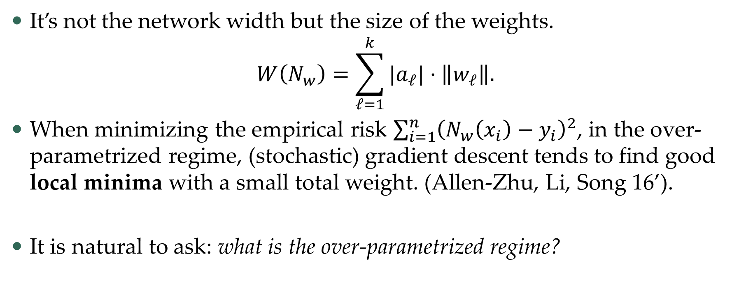
Possible Explanation
It’s not the network width but the size of the weights.
$$W\left(N_{w}\right)=\sum_{ℓ=1}^{k}{|a_{ℓ}|}⋅\left\|w_{ℓ}\right\|.$$
When minimizing the empirical risk $\sum_{i=1}^{n}{{\left(N_{w}\left(x_{i}\right)−y_{i}\right)}^{2}}$, in the over-parametrized regime, (stochastic) gradient descent tends to find good local minima with a small total weight. (Allen-Zhu, Li, Song 16’).
It is natural to ask: what is the over-parametrized regime?

Slide 5
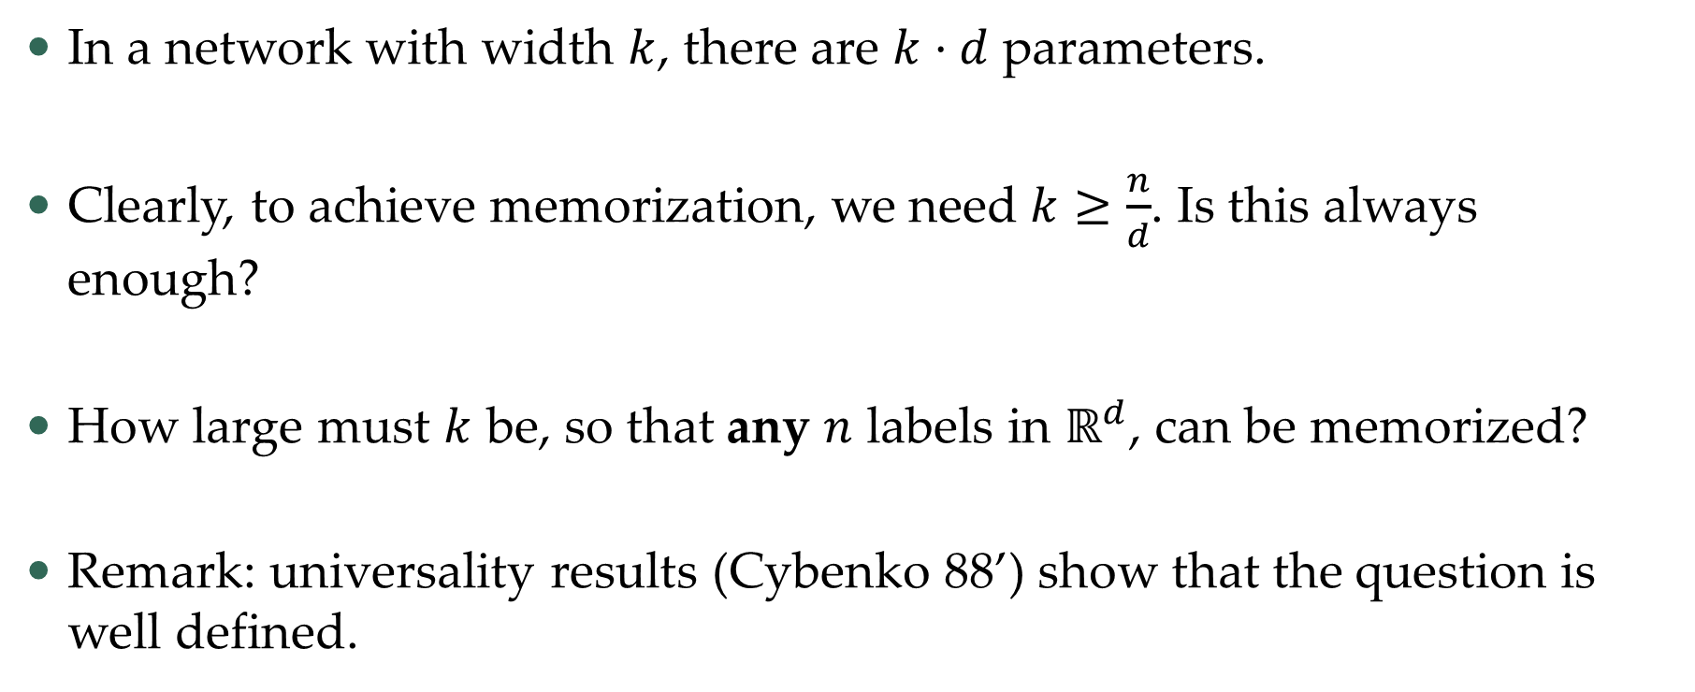
Over/under-parametrization
In a network with width $k$, there are $k⋅d$ parameters.
Clearly, to achieve memorization, we need $k≥\frac{n}{d}$. Is this always enough?
How large must $k$ be, so that any $n$ labels in $ℝ^{d}$, can be memorized?
Remark: universality results (Cybenko 88’) show that the question is well defined.

Slide 6
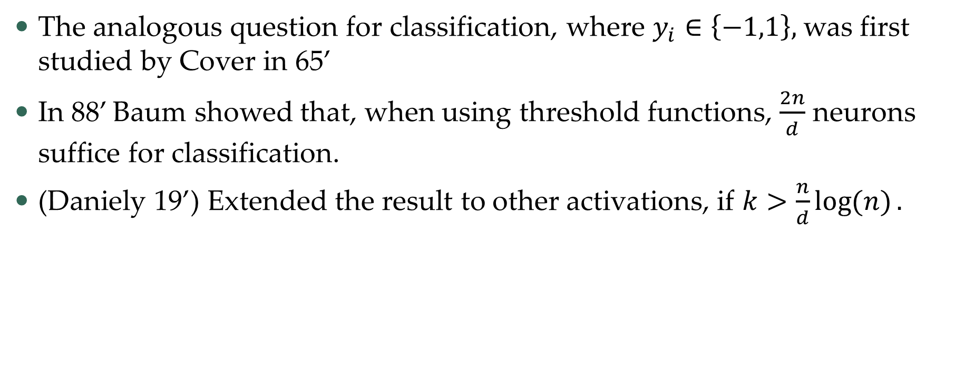
Some results (non-comprehensive)
The analogous question for classification, where $y_{i}∈\left\{−1,1\right\},$was first studied by Cover in 65’
In 88’ Baum showed that, when using threshold functions, $\frac{2n}{d}$ neurons suffice for classification.
(Daniely 19’) Extended the result to other activations, if $k>\frac{n}{d}\log{(n)}.$

Slide 7
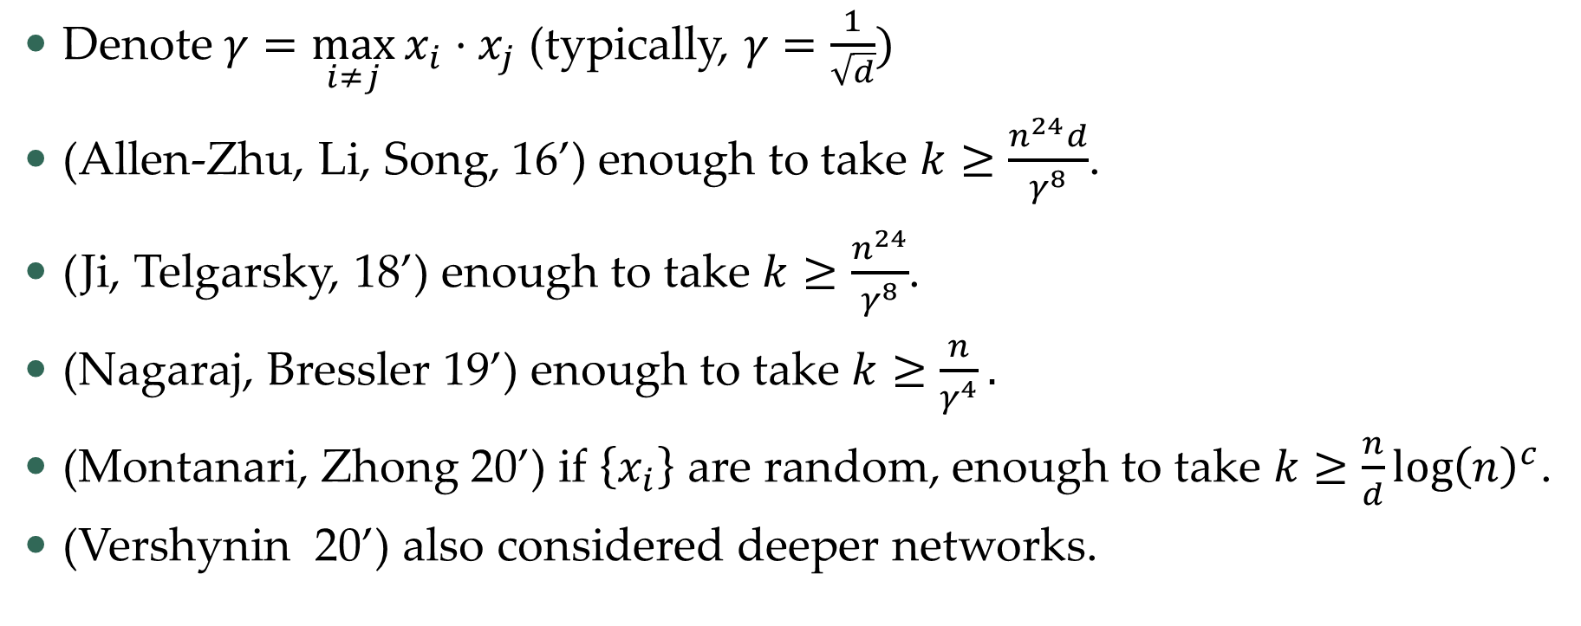
Some results (non-comprehensive)
Denote $γ=\max_{i≠j}{x_{i}⋅x_{j}}$ (typically, $γ=\frac{1}{\sqrt{d}})$
(Allen-Zhu, Li, Song, 16’) enough to take $k≥\frac{n^{24}d}{γ^{8}}$.
(Ji, Telgarsky, 18’) enough to take $k≥\frac{n^{24}}{γ^{8}}$.
(Nagaraj, Bressler 19’) enough to take $k≥\frac{n}{γ^{4}}.$
(Montanari, Zhong 20’) if $\left\{x_{i}\right\}$ are random, enough to take $k≥\frac{n}{d}{\log\left(n\right)}^{c}$.
(Vershynin 20’) also considered deeper networks.

Slide 8
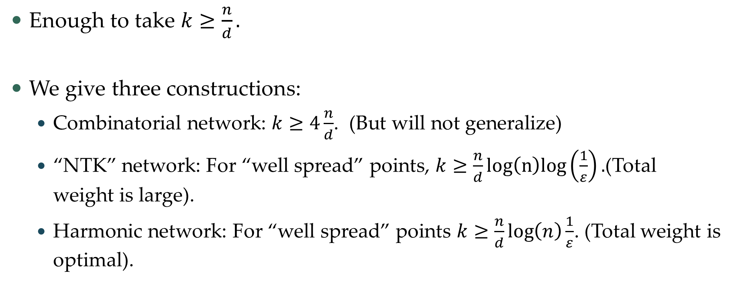
Today
Enough to take $k≥\frac{n}{d}.$
We give three constructions:
  Combinatorial network: $k≥4\frac{n}{d}$. (But will not generalize)
  “NTK” network: For “well spread” points, $k≥\frac{n}{d}log\left(n\right)log\left(\frac{1}{ε}\right).$(Total weight is large).
  Harmonic network: For “well spread” points $k≥\frac{n}{d}\log\left(n\right)\frac{1}{ε}$. (Total weight is optimal).

Slide 9
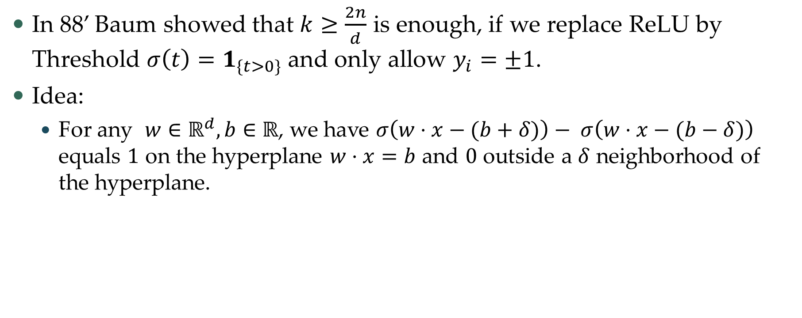
Combinatorial network – warm up
In 88’ Baum showed that $k≥\frac{2n}{d}$ is enough, if we replace ReLU by Threshold $σ\left(t\right)=1_{\{t>0\}}$and only allow $y_{i}=±1$.
Idea:
  For any $w∈ℝ^{d}, b∈$ $ℝ$, we have $σ\left(w⋅x−(b+δ)\right)− σ\left(w⋅x−(b−δ)\right)$ equals $1$ on the hyperplane $w⋅x=b$ and $0$ outside a $δ$ neighborhood of the hyperplane.

Slide 10
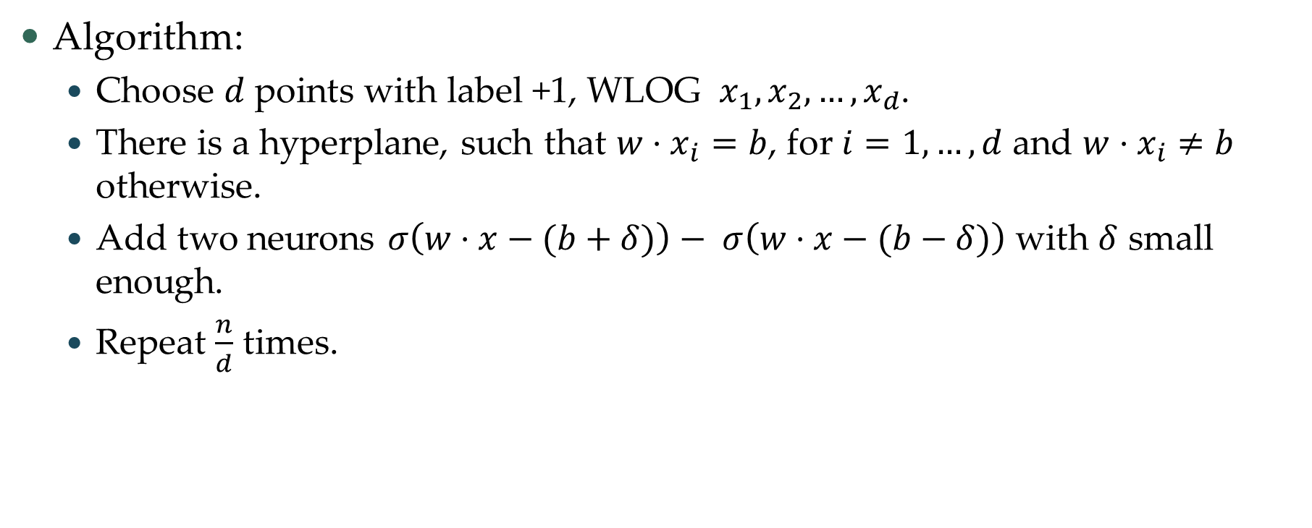
Combinatorial network – warm up
Algorithm:
  Choose $d$ points with label +1, WLOG $x_{1},x_{2},…,x_{d}$.
  There is a hyperplane, such that $w⋅x_{i}=b$, for $i=1,…,d$ and $w⋅x_{i}≠b$ otherwise.
  Add two neurons $σ\left(w⋅x−(b+δ)\right)− σ\left(w⋅x−(b−δ)\right)$ with $δ$ small enough.
  Repeat $\frac{n}{d}$ times.

Slide 11
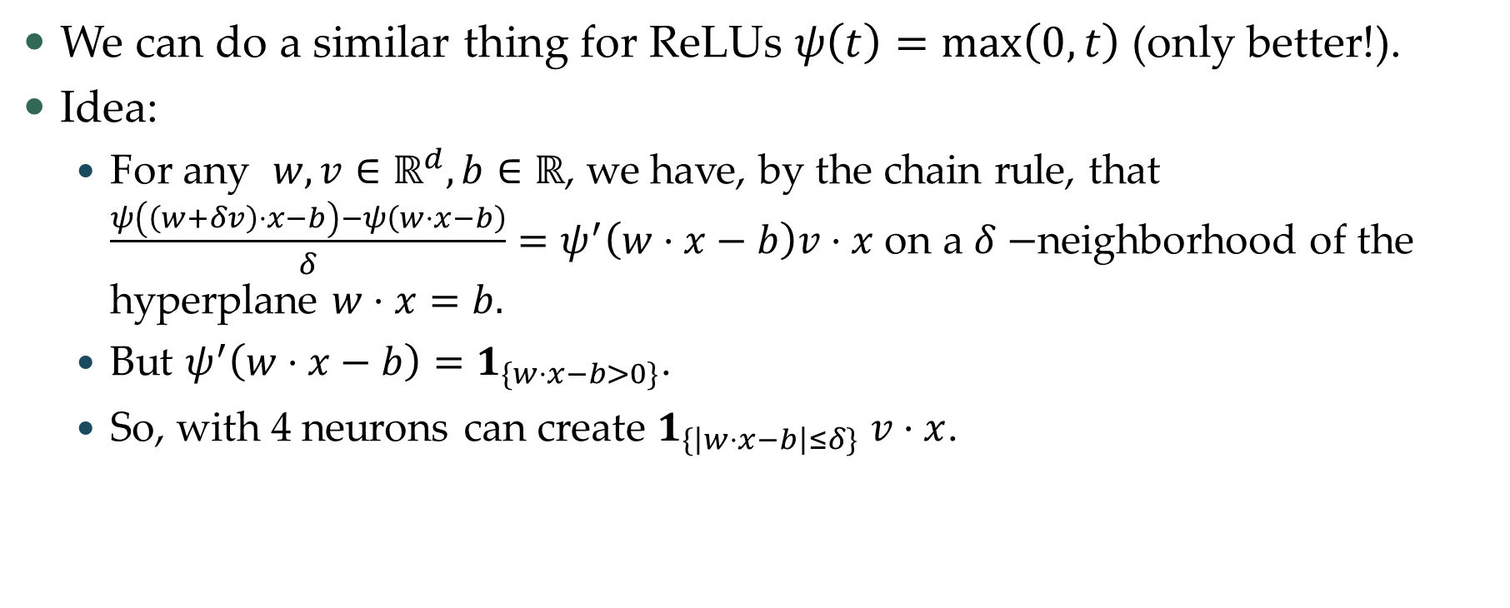
Combinatorial network – ReLU
We can do a similar thing for ReLUs $ψ\left(t\right)=\max\left(0,t\right)$(only better!).
Idea:
  For any $w,v∈ℝ^{d}, b∈ℝ$, we have, by the chain rule, that $\frac{ψ\left(\left(w+δv\right)⋅x−b\right)−ψ\left(w⋅x−b\right)}{δ}=ψ^{′}\left(w⋅x−b\right)v⋅x$ on a $δ−$neighborhood of the hyperplane $w⋅x=b.$
  But $ψ^{′}\left(w⋅x−b\right)=1_{\{w⋅x−b>0\}}$.
  So, with 4 neurons can create $1_{\{\left|w⋅x−b\right|≤δ\}}$ $v⋅x$.

Slide 12
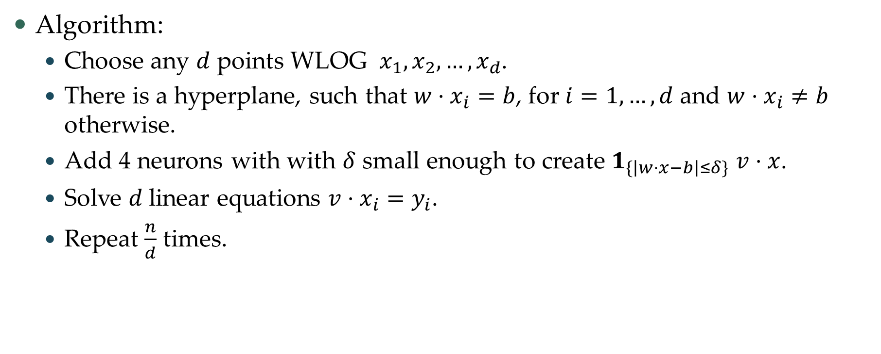
Combinatorial network – ReLUs
Algorithm:
  Choose any $d$ points WLOG $x_{1},x_{2},…,x_{d}$.
  There is a hyperplane, such that $w⋅x_{i}=b$, for $i=1,…,d$ and $w⋅x_{i}≠b$ otherwise.
  Add 4 neurons with with $δ$ small enough to create $1_{\{\left|w⋅x−b\right|≤δ\}}$ $v⋅x$.
  Solve $d$ linear equations $v⋅x_{i}=y_{i}$.
  Repeat $\frac{n}{d}$ times.

Slide 13


Combinatorial network – properties
The resulting network is highly tailored to the sample.
The network evaluates to $0$ on most of the sphere.
Weights can be pretty large.

Slide 14
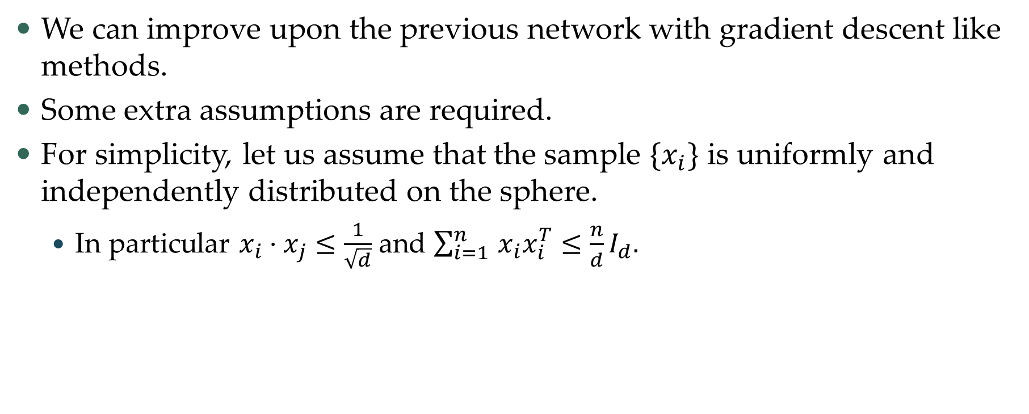
Improving
We can improve upon the previous network with gradient descent like methods.
Some extra assumptions are required.
For simplicity, let us assume that the sample $\{x_{i}\}$ is uniformly and independently distributed on the sphere.
  In particular $x_{i}⋅x_{j}≤\frac{1}{\sqrt{d}}$ and $\sum_{i=1 }^{n}{x_{i}x_{i}^{T}}≤\frac{n}{d}I_{d}.$

Slide 15
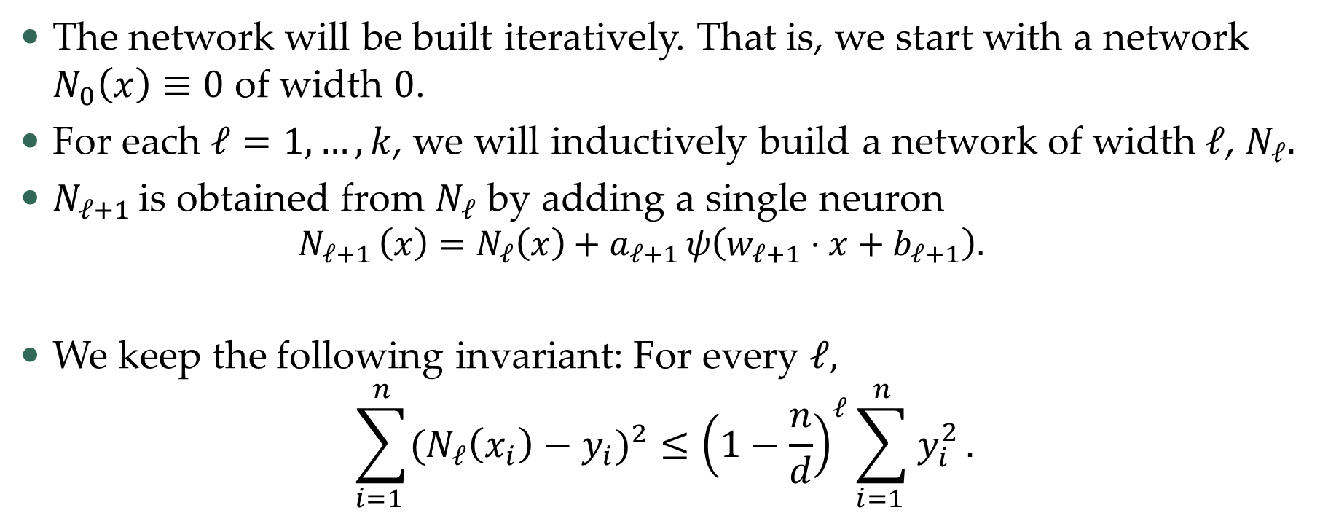
Boosting
The network will be built iteratively. That is, we start with a network $N_{0}\left(x\right)≡0$ of width $0$.
For each $ℓ=1,…,k$, we will inductively build a network of width$ℓ$, $N_{ℓ}.$
$N_{ℓ+1 }$is obtained from $N_{ℓ}$ by adding a single neuron
  $$N_{ℓ+1 }\left(x\right)=N_{ℓ}\left(x\right)+a_{ℓ+1 }ψ\left(w_{ℓ+1}⋅x+b_{ℓ+1}\right).$$
We keep the following invariant: For every $ℓ,$
$$\sum_{i=1 }^{n}{{(N}_{ℓ}\left(x_{i}\right)−y_{i})^{2}}≤{\left(1−\frac{n}{d}\right)}^{ℓ}\sum_{i=1 }^{n}{y_{i}^{2}}.$$

Slide 16
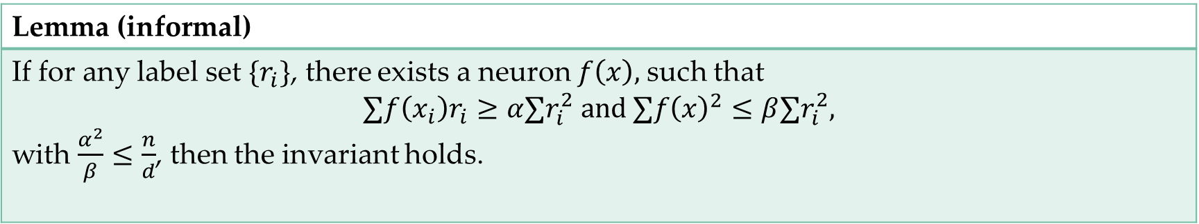

Boosting – basic observation
To keep the invariant we need the following result
Proof: Denote $η=\frac{α}{β},$ and at step $ℓ$ take $r_{i}=N_{ℓ}(x_{i})−y_{i}.$
$$∑{\left(η⋅f\left(x_{i}\right)−r_{i}\right)}^{2}=∑{(r}_{i}^{2}−2ηf\left(x_{i}\right)r_{i}+η^{2}f{\left(x_{i}\right)}^{2})≤(1−\frac{α^{2}}{β}) ∑r_{i}^{2} .$$
Lemma (informal)
If for any label set $\{r_{i}\}$, there exists a neuron $f\left(x\right),$such that $$∑f\left(x_{i}\right)r_{i}≥α∑r_{i}^{2} and ∑f{\left(x\right)}^{2}≤β∑r_{i}^{2},$$ with $\frac{α^{2}}{β}≤\frac{n}{d}$, then the invariant holds.

Slide 17
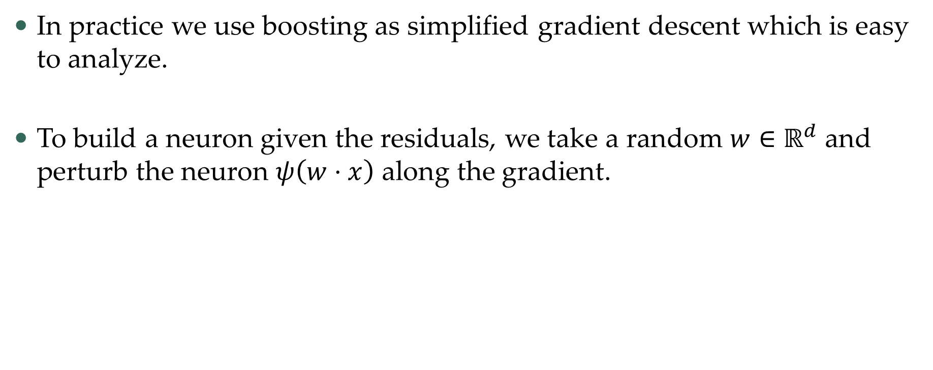
Boosting in practice
In practice we use boosting as simplified gradient descent which is easy to analyze.
To build a neuron given the residuals, we take a random $w∈ℝ^{d}$and perturb the neuron $ψ\left(w⋅x\right)$ along the gradient.

Slide 18
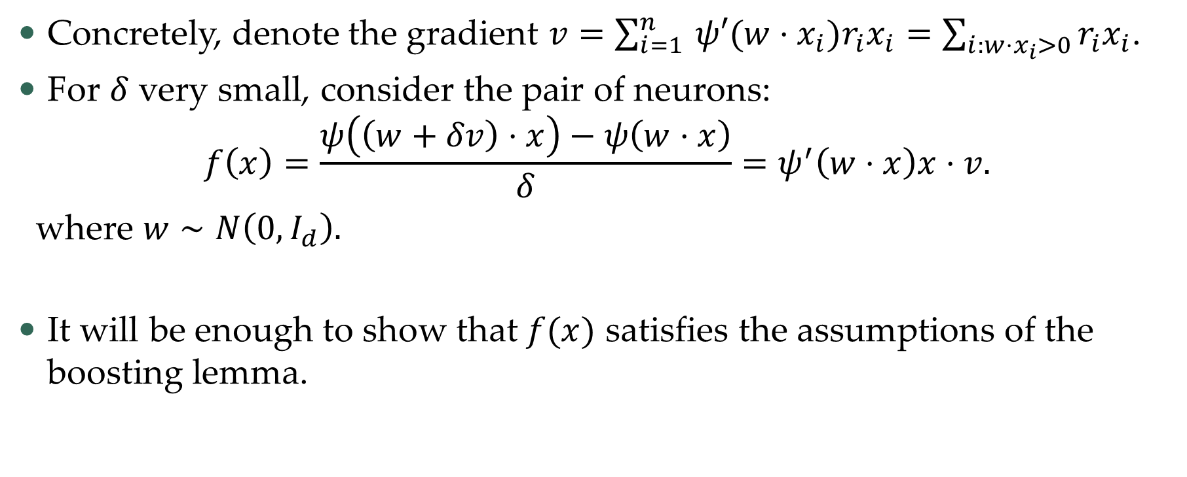
NTK regime
Concretely, denote the gradient $v=\sum_{i=1 }^{n}{{ψ′(w⋅x_{i})r}_{i}x_{i}}=\sum_{i:w⋅x_{i}>0}{r_{i}x_{i}}$.
For $δ$ very small, consider the pair of neurons:
$$f\left(x\right)=\frac{ψ\left(\left(w+δv\right)⋅x\right)−ψ\left(w⋅x\right)}{δ}=ψ^{′}\left(w⋅x\right)x⋅v.$$
where $w∼N\left(0, I_{d}\right).$
It will be enough to show that $f(x)$ satisfies the assumptions of the boosting lemma.

Slide 19
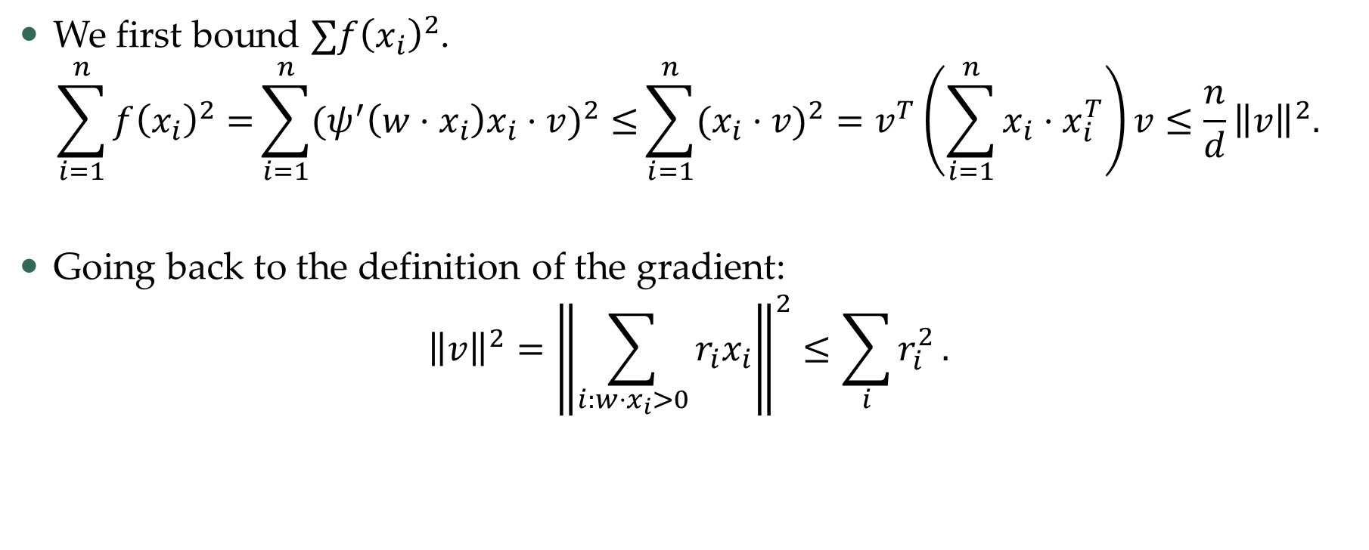
NTK regime – energy component
We first bound $∑f{\left(x_{i}\right)}^{2}$.
$$\sum_{i=1}^{n}{f{\left(x_{i}\right)}^{2}=}\sum_{i=1}^{n}{{(ψ}^{′}\left(w⋅x_{i}\right)x_{i}⋅v)^{2}≤}\sum_{i=1}^{n}{(x_{i}⋅v)^{2}=v^{T}\left(\sum_{i=1}^{n}{x_{i}⋅x_{i}^{T}}\right)v≤\frac{n}{d}{\left\|v\right\|}^{2}.}$$
Going back to the definition of the gradient:
$${\left\|v\right\|}^{2}={\left\|\sum_{i:w⋅x_{i}>0}{r_{i}x_{i}}\right\|}^{2}≤\sum_{i}{r_{i}^{2}}.$$

Slide 20
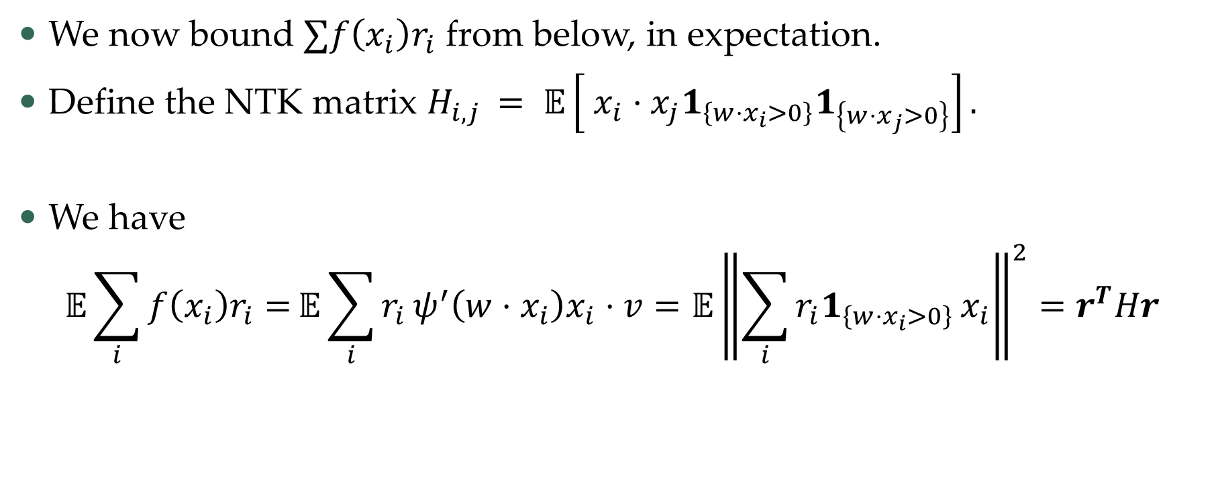
NTK regime – correlations
We now bound $∑f\left(x_{i}\right)r_{i}$ from below, in expectation.
Define the NTK matrix $H_{i,j }= 𝔼\left[ x_{i}⋅x_{j}1_{\left\{w⋅x_{i}>0\right\}}1_{\left\{w⋅x_{j}>0\right\}}\right].$
We have
$$𝔼\sum_{i}{f\left(x_{i}\right)r_{i}=}{𝔼\sum_{i}{r_{i}}ψ}^{′}\left(w⋅x_{i}\right)x_{i}⋅v=𝔼{\left\|\sum_{i}{r_{i}1_{\left\{w⋅x_{i}>0\right\}}}x_{i}\right\|}^{2}=r^{T}Hr$$

Slide 21
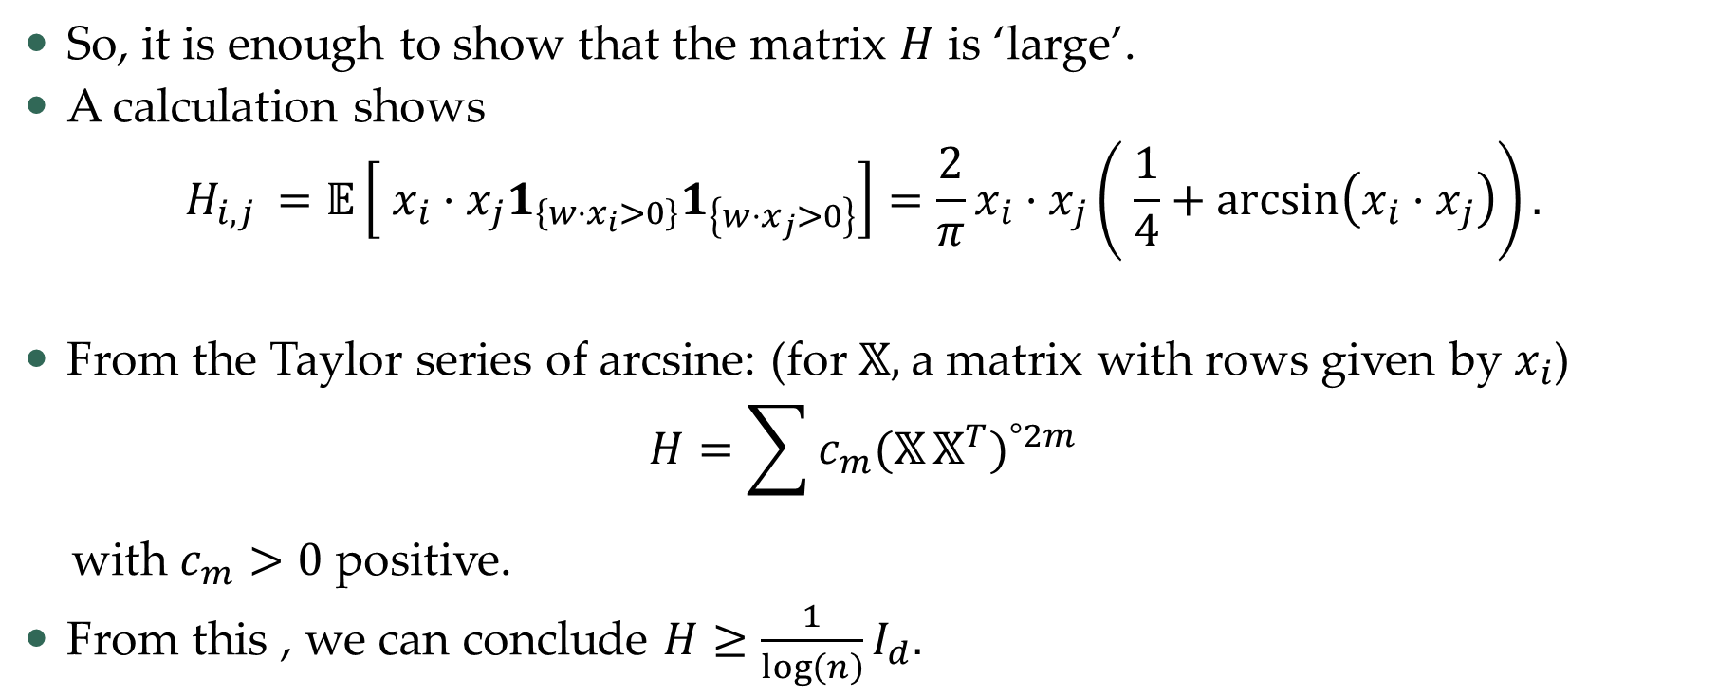
NTK regime – correlations
So, it is enough to show that the matrix $H$ is ‘large’.
A calculation shows
$$H_{i,j }=𝔼\left[ x_{i}⋅x_{j}1_{\left\{w⋅x_{i}>0\right\}}1_{\left\{w⋅x_{j}>0\right\}}\right]=\frac{2}{π}x_{i}⋅x_{j}\left( \frac{1}{4}+\arcsin\left(x_{i}⋅x_{j}\right)\right).$$
From the Taylor series of arcsine: (for $𝕏,$a matrix with rows given by $x_{i}$)
$$H=\sum{c_{m}(𝕏}𝕏^{T})^{°2m}$$
with $c_{m}>0$ positive.
From this , we can conclude $H≥\frac{1}{\log\left(n\right)}I_{d}.$

Slide 22
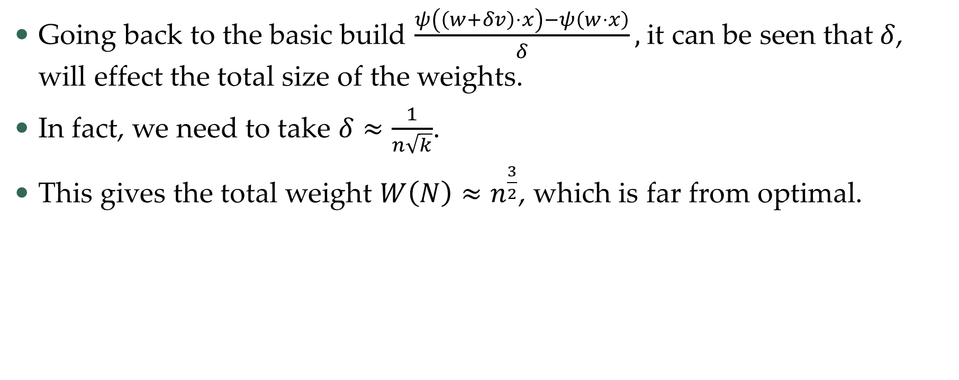
NTK regime – weights
Going back to the basic build $\frac{ψ\left(\left(w+δv\right)⋅x\right)−ψ\left(w⋅x\right)}{δ},$it can be seen that $δ$, will effect the total size of the weights.
In fact, we need to take $δ≈\frac{1}{n\sqrt{k}}$.
This gives the total weight $W\left(N\right)≈n^{\frac{3}{2}}$, which is far from optimal.

Slide 23
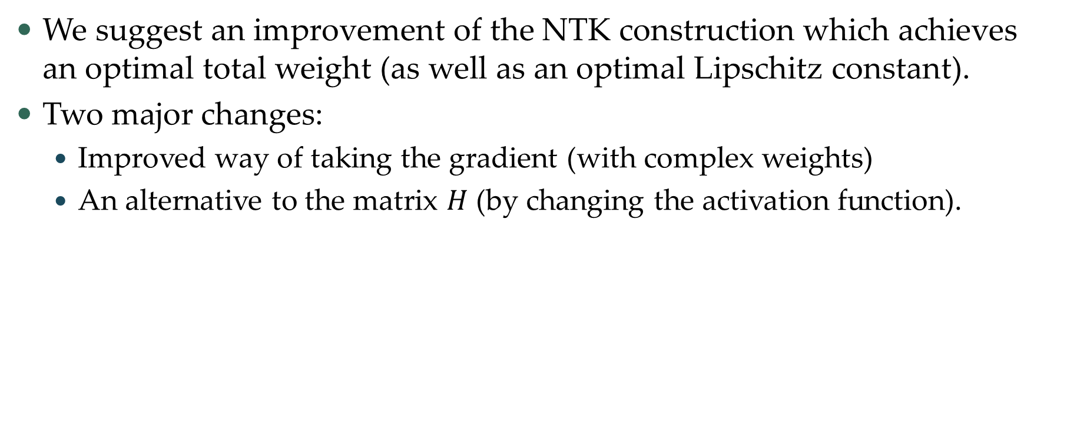
Improving upon NTK
We suggest an improvement of the NTK construction which achieves an optimal total weight (as well as an optimal Lipschitz constant).
Two major changes:
  Improved way of taking the gradient (with complex weights)
  An alternative to the matrix $H$ (by changing the activation function).

Slide 24
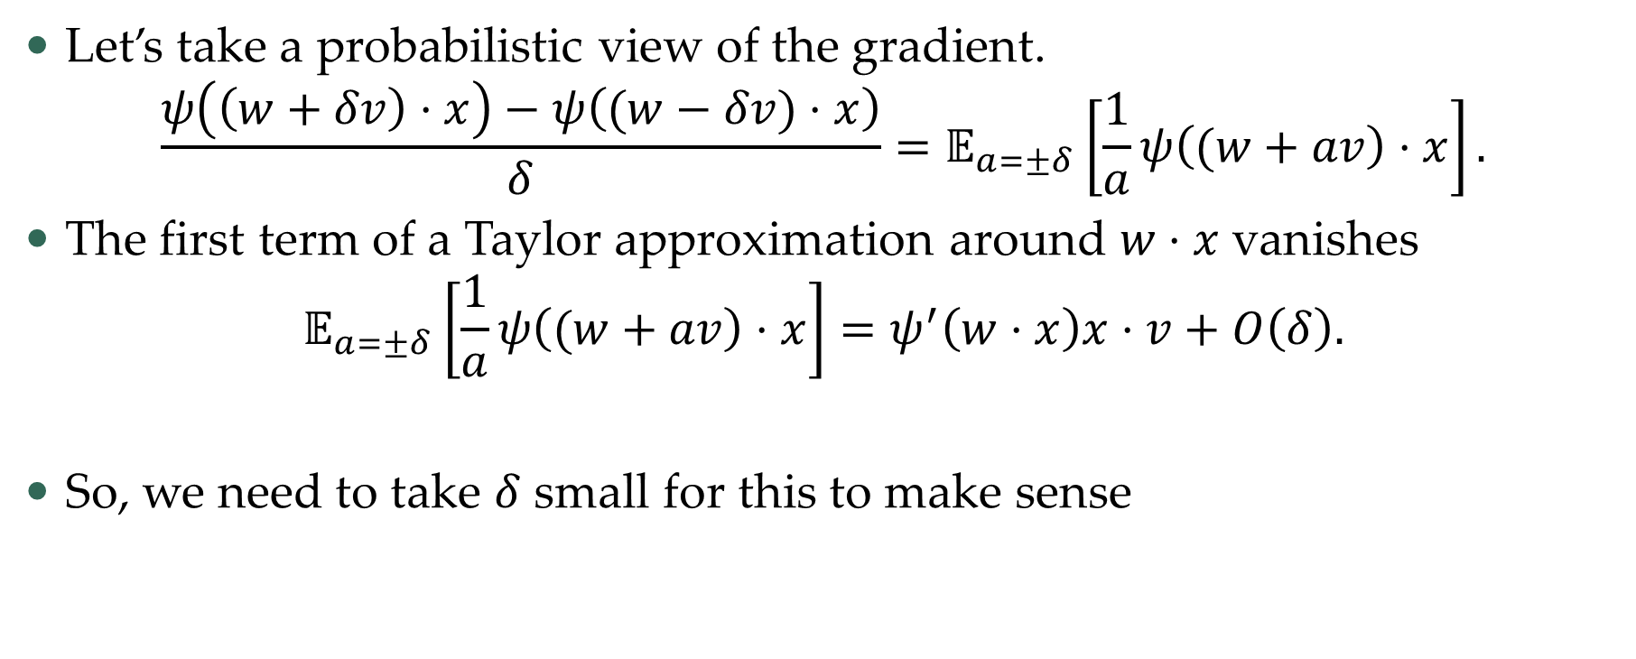
Complex trick
Let’s take a probabilistic view of the gradient.
$$\frac{ψ\left(\left(w+δv\right)⋅x\right)−ψ\left((w−δv)⋅x\right)}{δ}=𝔼_{a=±δ}\left[\frac{1}{a}ψ\left((w+av\right)⋅x\right].$$
The first term of a Taylor approximation around $w⋅x$vanishes
$$𝔼_{a=±δ}\left[\frac{1}{a}ψ\left((w+av\right)⋅x\right]=ψ^{′}\left(w⋅x\right)x⋅v+O\left(δ\right).$$
So, we need to take $δ$ small for this to make sense

Slide 25
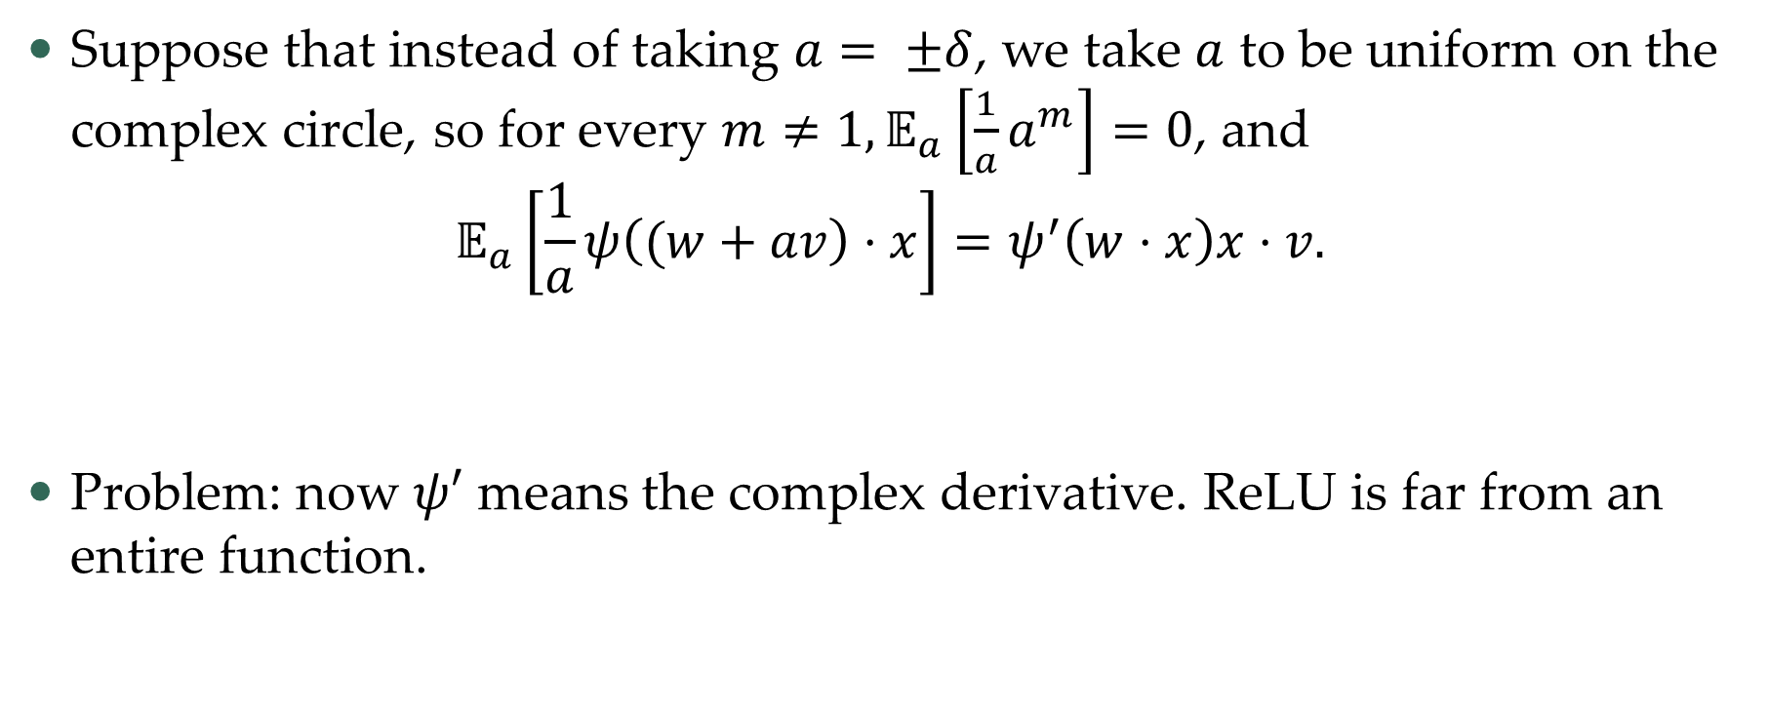
Complex trick
Suppose that instead of taking $a= ±δ$, we take $a$ to be uniform on the complex circle, so for every $m≠1,𝔼_{a}\left[\frac{1}{a}a^{m}\right]=0$, and
$$𝔼_{a}\left[\frac{1}{a}ψ\left((w+av\right)⋅x\right]=ψ^{′}\left(w⋅x\right)x⋅v.$$
Problem: now $ψ′$ means the complex derivative. ReLU is far from an entire function.

Slide 26
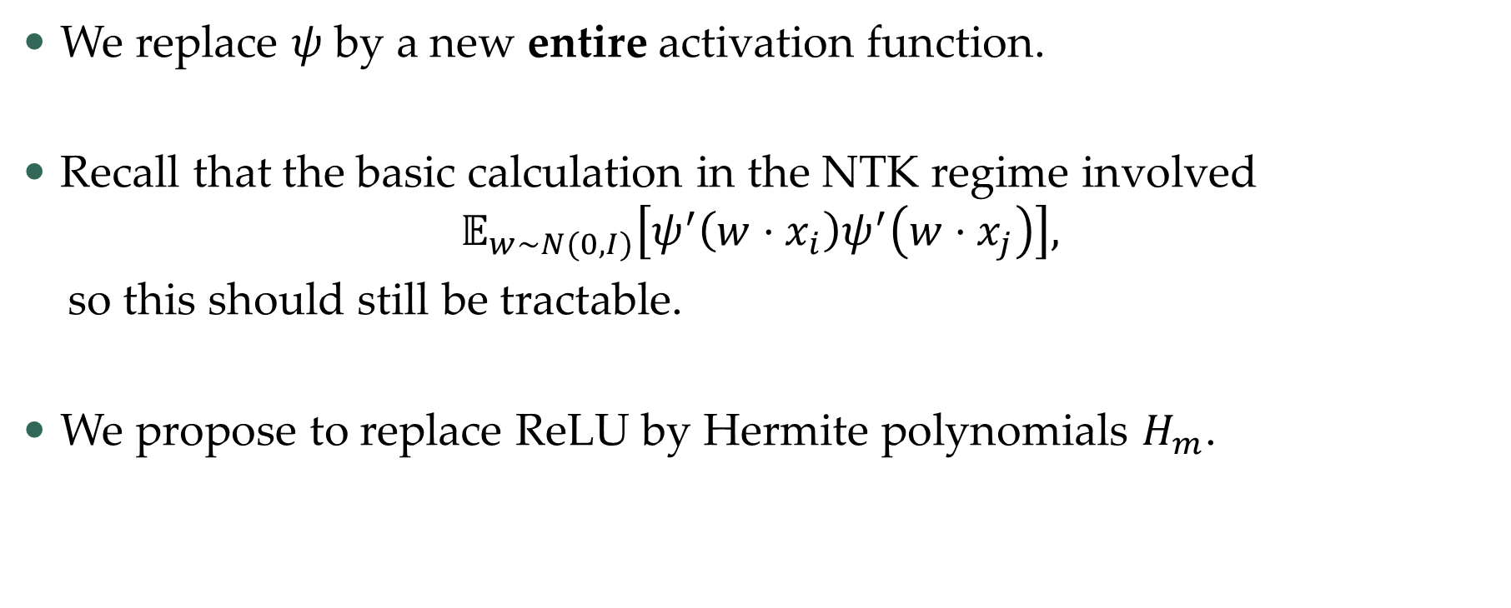
A new activation
We replace $ψ$ by a new entire activation function.
Recall that the basic calculation in the NTK regime involved
$$𝔼_{w∼N(0,I)}\left[ψ^{′}\left(w⋅x_{i}\right)ψ^{′}\left(w⋅x_{j}\right)\right],$$
so this should still be tractable.
We propose to replace ReLU by Hermite polynomials $H_{m}$.

Slide 27
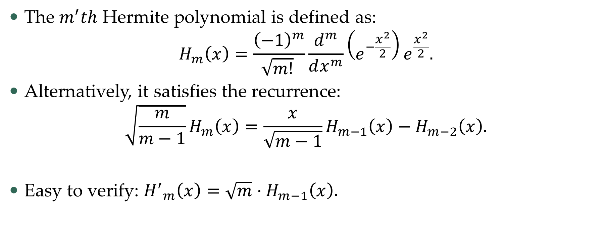
Hermite polynomials 101
The $m^{′}th$ Hermite polynomial is defined as:
$$H_{m}\left(x\right)=\frac{{\left(−1\right)}^{m}}{\sqrt{m!} }\frac{d^{m}}{dx^{m}}\left(e^{−\frac{x^{2}}{2}}\right)e^{\frac{x^{2}}{2}}.$$
Alternatively, it satisfies the recurrence:
$$\sqrt{\frac{m}{m−1}}H_{m}\left(x\right)=\frac{x}{\sqrt{m−1}}H_{m−1}\left(x\right)−H_{m−2}\left(x\right).$$
Easy to verify: ${H^{′}}_{m}\left(x\right)={\sqrt{m}⋅H}_{m−1}\left(x\right).$

Slide 28
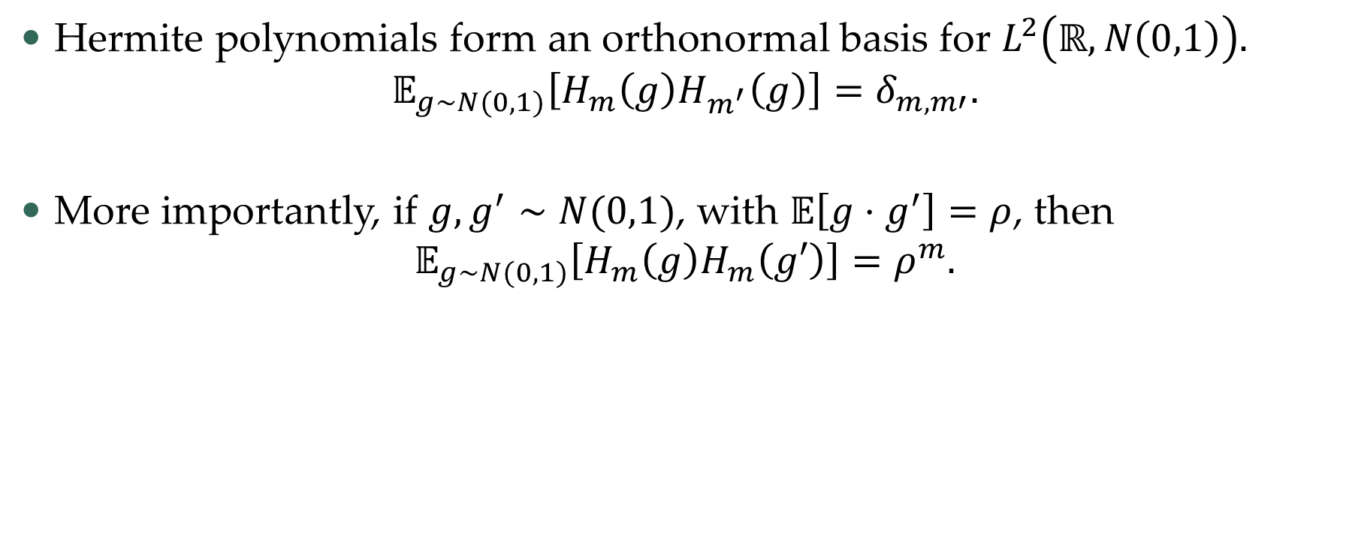
Hermite polynomials 101
Hermite polynomials form an orthonormal basis for $L^{2}\left(ℝ,N\left(0,1\right)\right).$
$$𝔼_{g∼N(0,1)}\left[H_{m}\left(g\right)H_{m^{′}}\left(g\right)\right]=δ_{m,m′}.$$
More importantly, if $g,g^{′}∼N(0,1)$, with $𝔼\left[g⋅g^{′}\right]=ρ$, then
$$𝔼_{g∼N(0,1)}\left[H_{m}\left(g\right)H_{m}\left(g′\right)\right]=ρ^{m}.$$

Slide 29
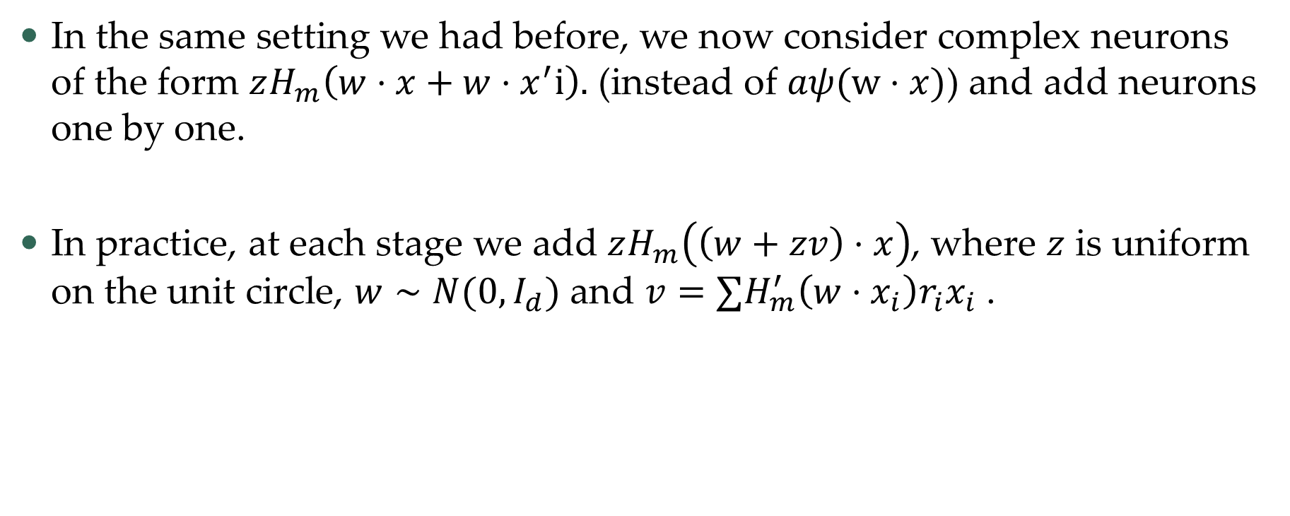
Harmonic network
In the same setting we had before, we now consider complex neurons of the form $zH_{m}\left(w⋅x+{w⋅x}^{′}i\right).$ (instead of $aψ(w⋅x)$) and add neurons one by one.
In practice, at each stage we add $zH_{m}\left(\left(w+zv\right)⋅x\right)$, where $z$ is uniform on the unit circle, $w∼N(0,I_{d})$ and $v=∑H_{m}^{′}\left(w⋅x_{i}\right)r_{i}x_{i}$.

Slide 30
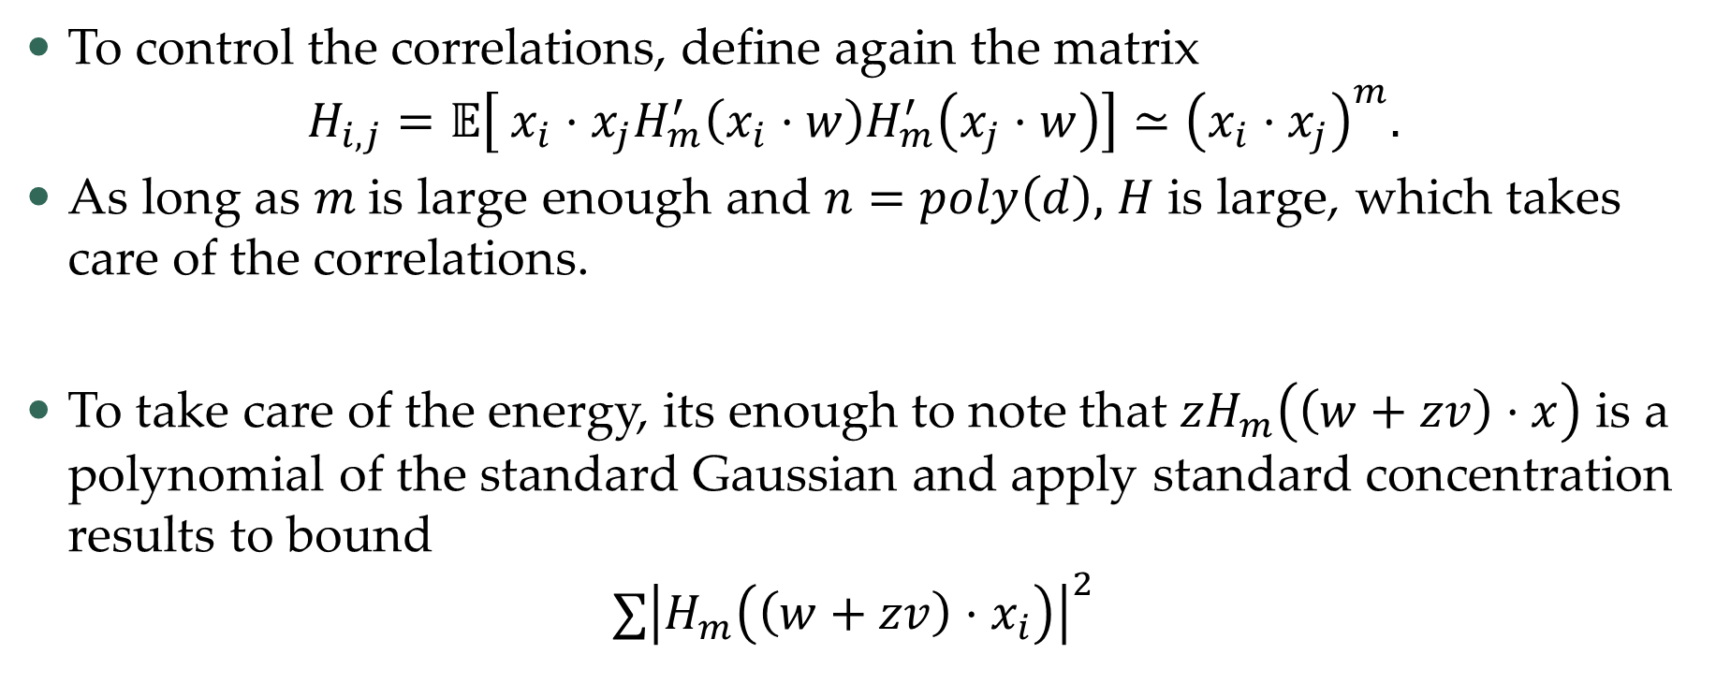
Correlation and energy
To control the correlations, define again the matrix
$$H_{i,j}=𝔼\left[ x_{i}⋅x_{j}H_{m}^{′}\left(x_{i}⋅w\right)H_{m}^{′}\left(x_{j}⋅w\right)\right]≃{\left(x_{i}⋅x_{j}\right)}^{m}.$$
As long as $m$is large enough and $n=poly\left(d\right),$ $H$ is large, which takes care of the correlations.
To take care of the energy, its enough to note that $zH_{m}\left(\left(w+zv\right)⋅x\right)$ is a polynomial of the standard Gaussian and apply standard concentration results to bound
$$∑{\left|H_{m}\left(\left(w+zv\right)⋅x_{i}\right)\right|}^{2}$$

Slide 31
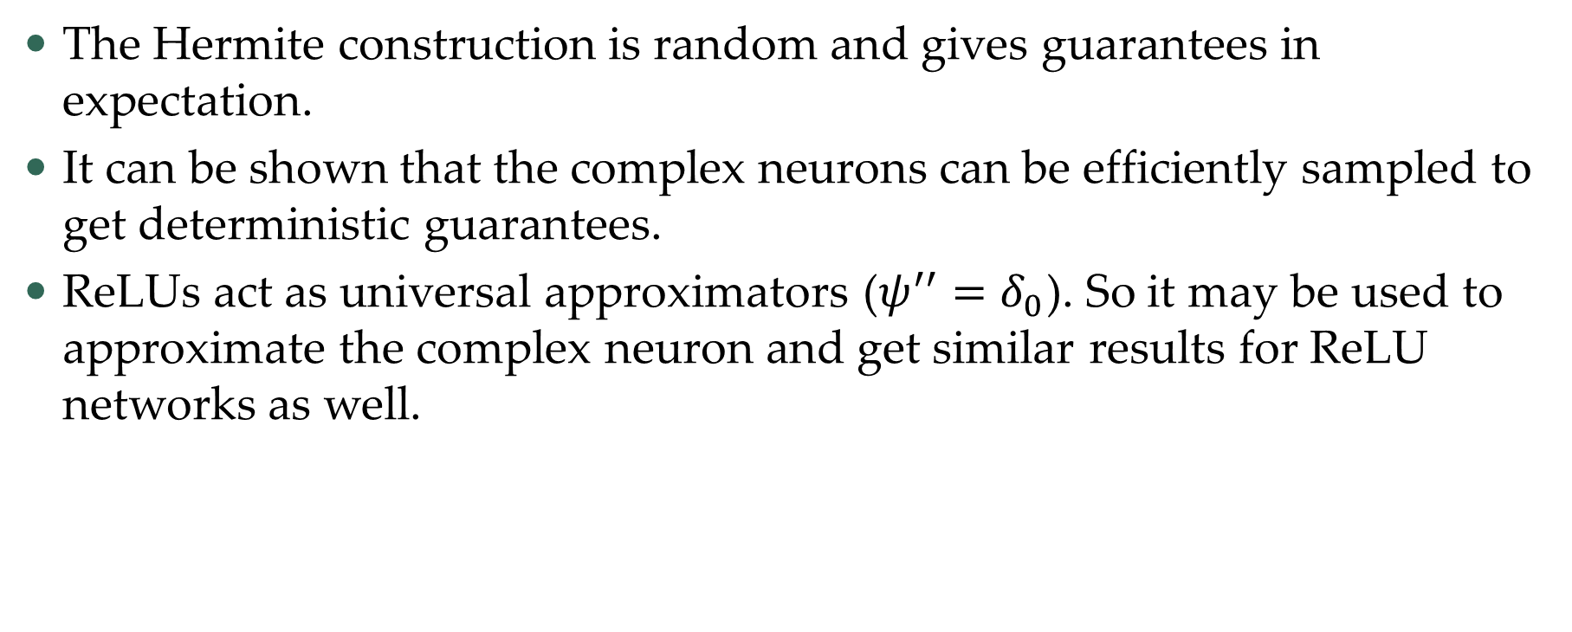
Going back to ReLUs
The Hermite construction is random and gives guarantees in expectation.
It can be shown that the complex neurons can be efficiently sampled to get deterministic guarantees.
ReLUs act as universal approximators ($ψ^{′′}=δ_{0}$). So it may be used to approximate the complex neuron and get similar results for ReLU networks as well.

Slide 32
Combinatorial network – warm up
In 88’ Baum showed that $k≥\frac{2n}{d}$ is enough, if we replace ReLU by Threshold $σ\left(t\right)=1_{\{t>0\}}$and only allow $y_{i}=±1$.
Idea:
  For any $w∈ℝ^{d}, b∈$ $ℝ$, we have $σ\left(w⋅x−(b+δ)\right)− σ\left(w⋅x−(b−δ)\right)$ equals $1$ on the hyperplane $w⋅x=b$ and $0$ outside a $δ$ neighborhood of the hyperplane.

Slide 33
Combinatorial network – warm up
Algorithm:
  Choose $d$ points with label +1, WLOG $x_{1},x_{2},…,x_{d}$.
  There is a hyperplane, such that $w⋅x_{i}=b$, for $i=1,…,d$ and $w⋅x_{i}≠b$ otherwise.
  Add two neurons $σ\left(w⋅x−(b+δ)\right)− σ\left(w⋅x−(b−δ)\right)$ with $δ$ small enough.
  Repeat $\frac{n}{d}$ times.

Slide 34
Combinatorial network – ReLU
We can do a similar thing for ReLUs $ψ\left(t\right)=\max\left(0,t\right)$(only better!).
Idea:
  For any $w,v∈ℝ^{d}, b∈ℝ$, we have, by the chain rule, that $\frac{ψ\left(\left(w+δv\right)⋅x−b\right)−ψ\left(w⋅x−b\right)}{δ}=ψ^{′}\left(w⋅x−b\right)v⋅x$ on a $δ−$neighborhood of the hyperplane $w⋅x=b.$
  But $ψ^{′}\left(w⋅x−b\right)=1_{\{w⋅x−b>0\}}$.
  So, with 4 neurons can create $1_{\{\left|w⋅x−b\right|≤δ\}}$ $v⋅x$.

Slide 35
Combinatorial network – ReLUs
Algorithm:
  Choose any $d$ points WLOG $x_{1},x_{2},…,x_{d}$.
  There is a hyperplane, such that $w⋅x_{i}=b$, for $i=1,…,d$ and $w⋅x_{i}≠b$ otherwise.
  Add 4 neurons with with $δ$ small enough to create $1_{\{\left|w⋅x−b\right|≤δ\}}$ $v⋅x$.
  Solve $d$ linear equations $v⋅x_{i}=y_{i}$.
  Repeat $\frac{n}{d}$ times.

Slide 36
Combinatorial network – properties
The resulting network is highly tailored to the sample.
The network evaluates to $0$ on most of the sphere.
Weights can be pretty large.

Slide 37
Improving
We can improve upon the previous network with gradient descent like methods.
Some extra assumptions are required.
For simplicity, let us assume that the sample $\{x_{i}\}$ is uniformly and independently distributed on the sphere.
  In particular $x_{i}⋅x_{j}≤\frac{1}{\sqrt{d}}$ and $\sum_{i=1 }^{n}{x_{i}x_{i}^{T}}≤\frac{n}{d}I_{d}.$

